Slide 1
Source Transformations

Slide 2
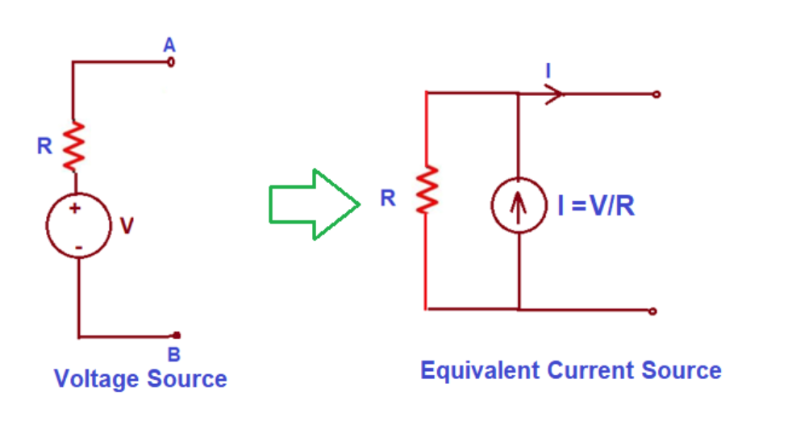
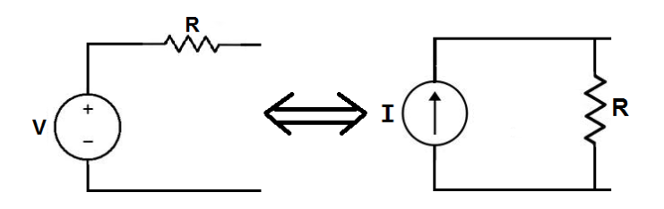
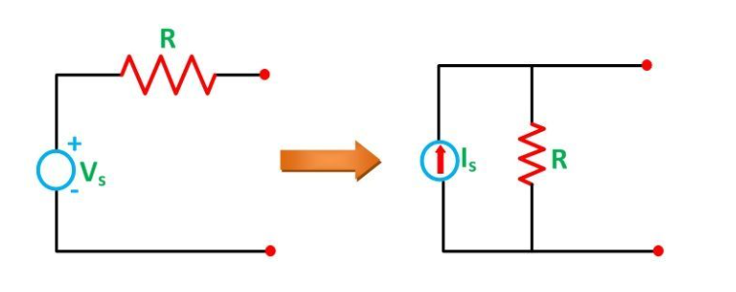

Slide 3
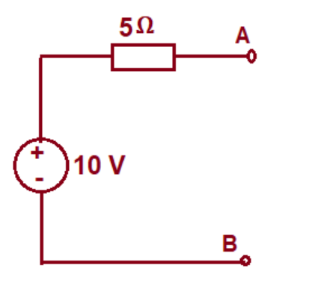
Example: Obtain an equivalent current source for the given voltage source

Slide 4
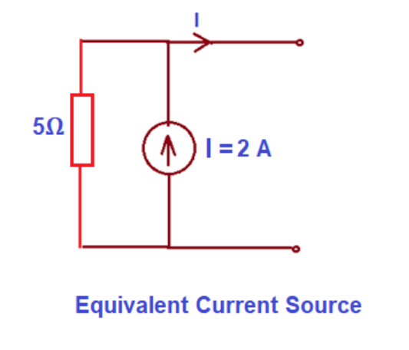

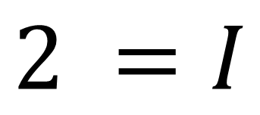
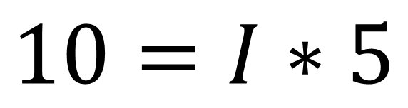
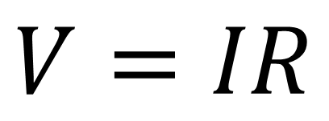


Example: Obtain an equivalent current source for the given voltage source
$$SOLUTION$$
$$V=IR$$
$$10=I∗5$$
$$↔$$
$$2 =I$$
$$I=2 Amp$$

Slide 5
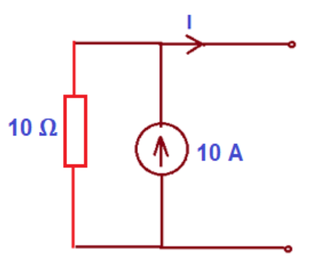
Example: Convert the following current source to equivalent voltage source.

Slide 6
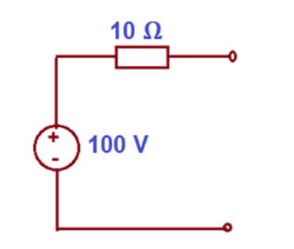

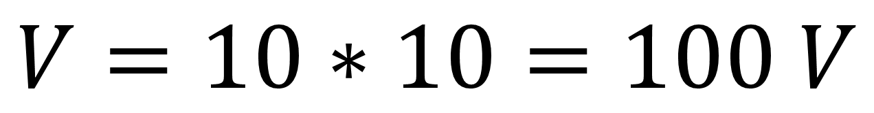
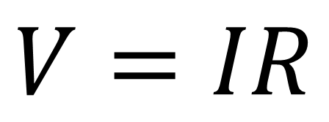
Example: Convert the following current source to equivalent voltage source.
$$SOLUTION$$
$$V=IR$$
$$V=10∗10=100 V$$

Slide 7
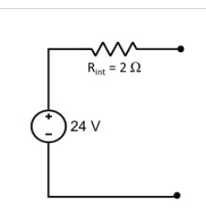
Q: Convert a voltage source of 24 V having a series internal resistance of 2 Ω into an equivalent current source.

Slide 8
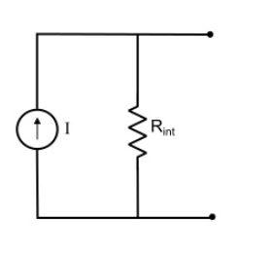

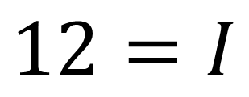
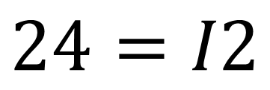
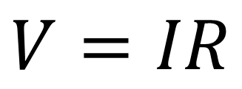
Q: Convert a voltage source of 24 V having a series internal resistance of 2 Ω into an equivalent current source.
$$SOLUTION$$
$$V=IR$$
$$24=I2$$
$$12=I$$

Slide 9
Source Transformation Circuits
Superposition Theorem
Norton Theorem
Millman Theorem
Thevenin Theorem

Slide 10
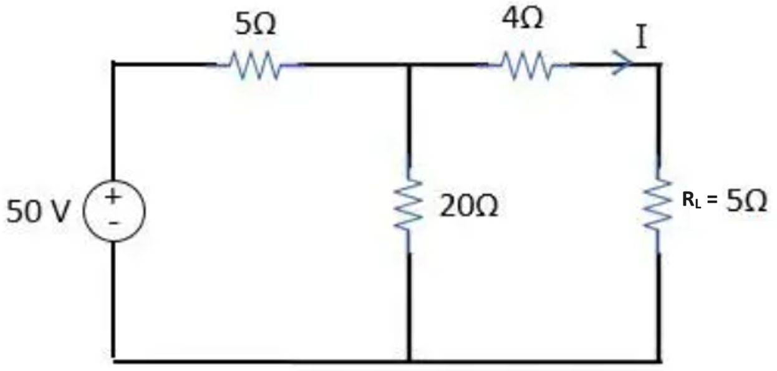
Q: Find V_{TH}, R_{TH} and the load current I_{L} flowing through and load voltage across the load resistor in fig by using Thevenin’s Theorem.

Slide 11
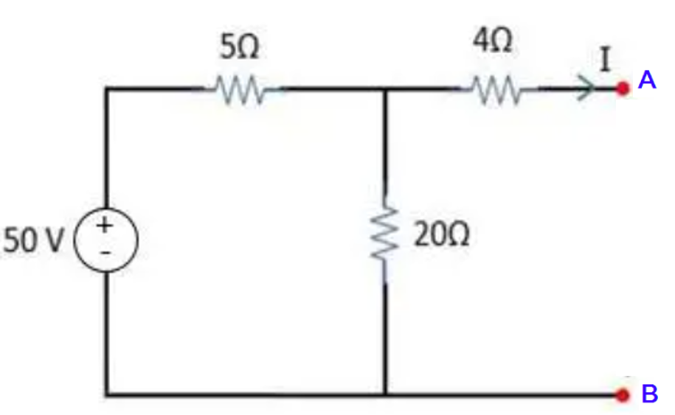
STEP 1. Remove the Load Resistance (R_{L}) as an open terminal / circuit.

Slide 12
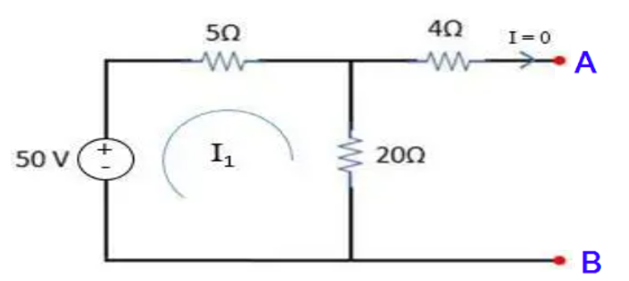
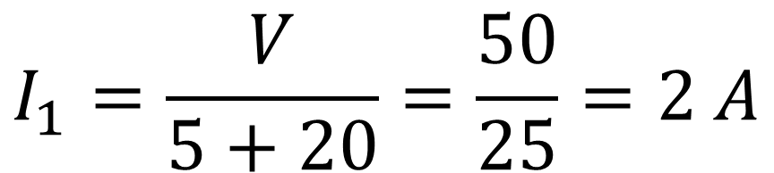
STEP 2. Calculate the open circuit voltage OR Thevenin Voltage (V_{TH}).
$$I_{1}=\frac{V}{5+20}=\frac{50}{25}=2 A$$
$$Voltage Across 20 k =I_{1}∗20=2∗20 =40 V$$
$$OR Thevenin VoltageV_{TH} =40 V$$

Slide 13
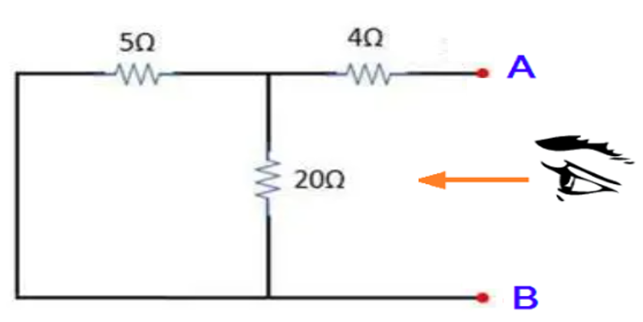
STEP 3. Find the Thevenin Resistance (R_{TH}), Remove the Voltage Sources from the Circuit.

Slide 14
$$R_{TH}=4+\left(20 || 5\right)=4+\frac{20∗5}{20+5}=4+\frac{100}{25}=4+4=8 $$

Slide 15
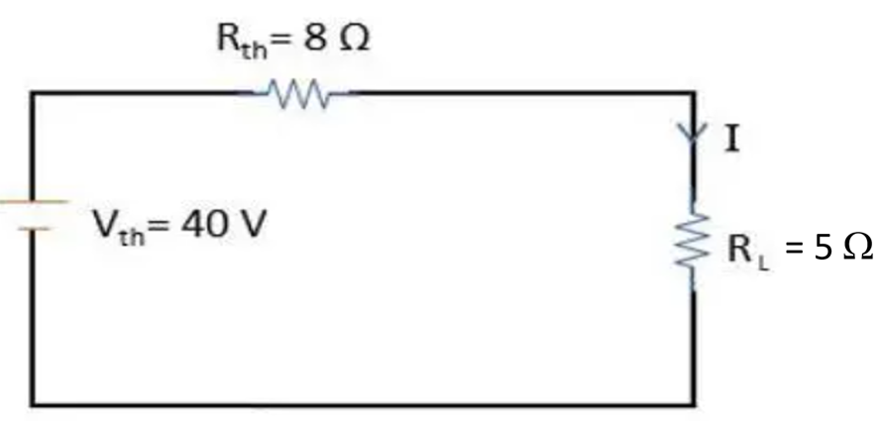
STEP 5. Draw Thevenin’s Equivalent Circuit and connected with load resistance R_{L}. V_{TH} = 40, R_{TH} = 8 Ω , and R_{L} = 5Ω.

Slide 16
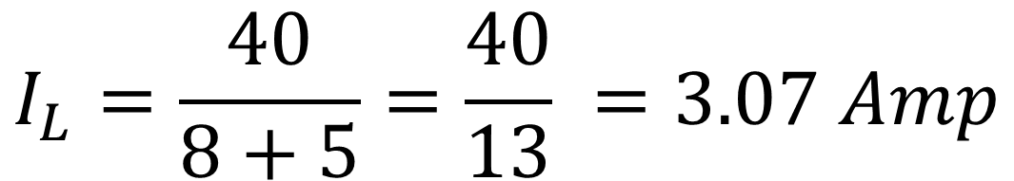
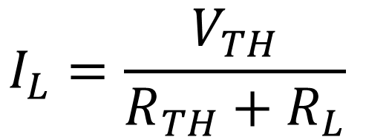
STEP 6. Calculate the total load current and load voltage.
$$I_{L}=\frac{V_{TH}}{R_{TH}+R_{L}}$$
$$I_{L}=\frac{40}{8+5}=\frac{40}{13} =3.07 Amp$$
$$V_{L}=I_{L}∗R_{L}=3.07 ∗5=15.38 Volts −−−Answer$$

Slide 17
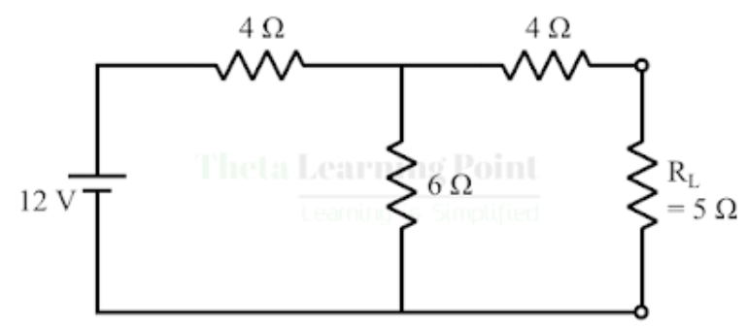
Q: Find V_{TH}, R_{TH} and the load current I_{L} flowing through and load voltage across the load resistor in fig by using Thevenin’s Theorem.

Slide 18
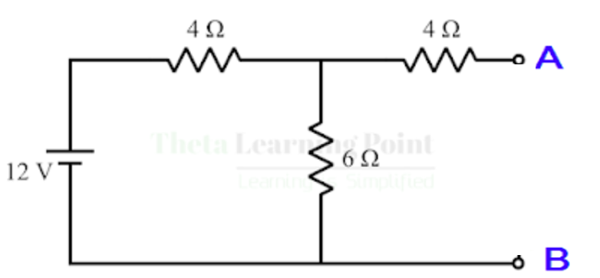
STEP 1. Remove the Load Resistance (R_{L}) as an open terminal / circuit.

Slide 19
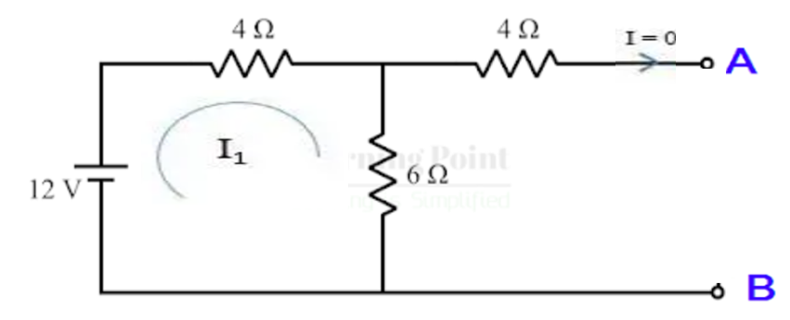
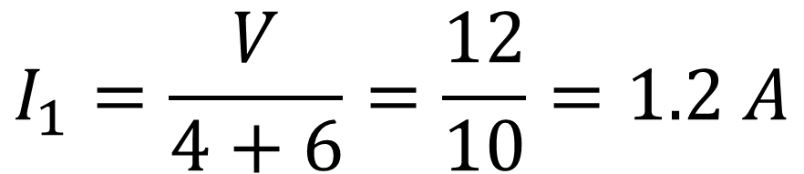
STEP 2. Calculate the open circuit voltage OR Thevenin Voltage (V_{TH}).
$$I_{1}=\frac{V}{4+6}=\frac{12}{10}=1.2 A$$
$$Voltage Across 6  =I_{1}∗6=1.2∗6 =7.2 V$$
$$OR Thevenin VoltageV_{TH} =7.2 V$$

Slide 20
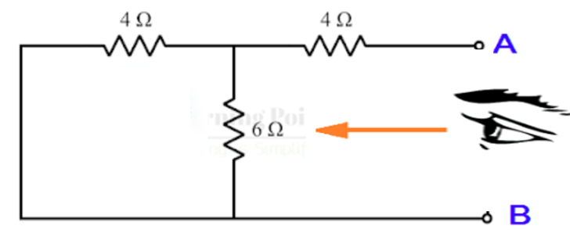
STEP 3. Find the Thevenin Resistance (R_{TH}), Remove the Voltage Sources from the Circuit.

Slide 21
$$R_{TH}=4+\left(6 ||4\right)=4+\frac{6∗4}{6+4}=4+\frac{24}{10}=4+2.4=6.4 $$

Slide 22
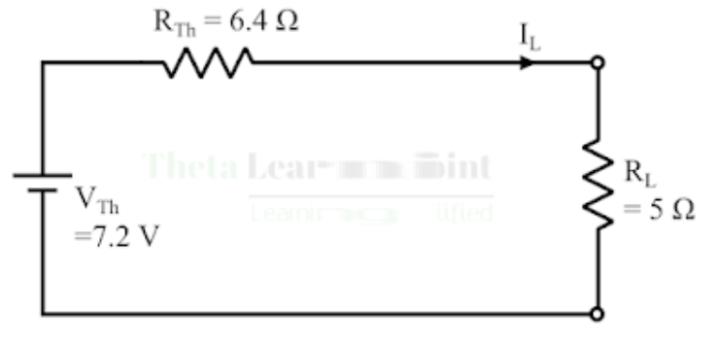
STEP 5. Draw Thevenin’s Equivalent Circuit and connected with load resistance R_{L}. V_{TH} = 7.2, R_{TH} = 6.4 Ω, and R_{L} = 5Ω.

Slide 23
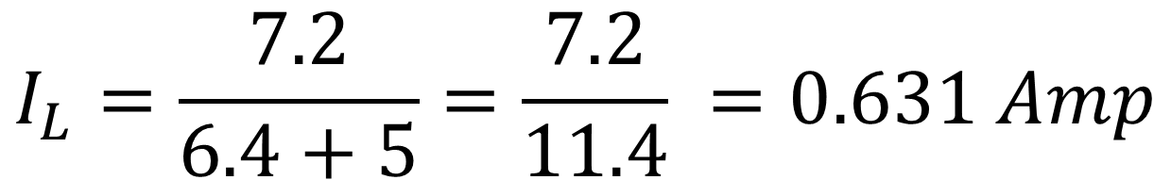
STEP 6. Calculate the total load current and load voltage.
$$I_{L}=\frac{V_{TH}}{R_{TH}+R_{L}}$$
$$I_{L}=\frac{7.2}{6.4+5}=\frac{7.2}{11.4} =0.631 Amp$$
$$V_{L}=I_{L}∗R_{L}=0.631 ∗5=3.15 −−−Answer$$

Slide 24
Millman’s Theorem

Slide 25
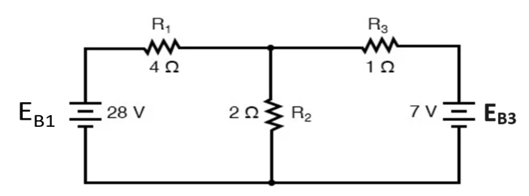
Q: Apply the Millman's Theorem on the below circuit.

Slide 26
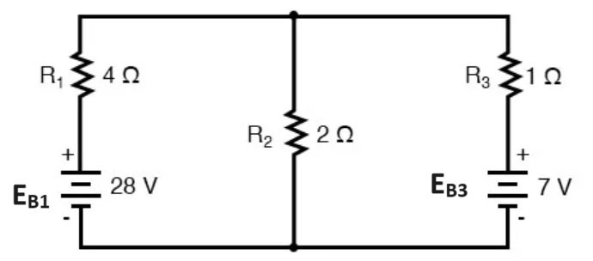
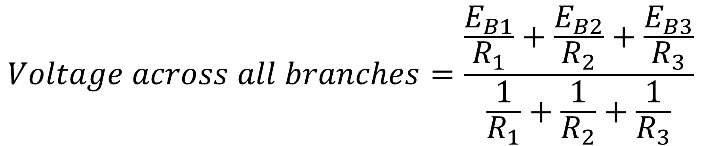
Step-2: Apply Millman’s Theorem Equation
$$Voltage across all branches=\frac{\frac{E_{B1}}{R_{1}}+\frac{E_{B2}}{R_{2}}+\frac{E_{B3}}{R_{3}}}{\frac{1}{R_{1}}+\frac{1}{R_{2}}+\frac{1}{R_{3}}}$$

Slide 27
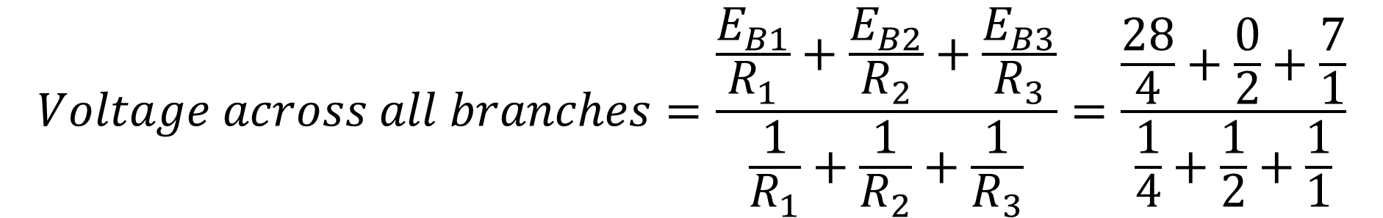
Step-2: Apply Millman’s Theorem Equation
$$Voltage across all branches=\frac{\frac{E_{B1}}{R_{1}}+\frac{E_{B2}}{R_{2}}+\frac{E_{B3}}{R_{3}}}{\frac{1}{R_{1}}+\frac{1}{R_{2}}+\frac{1}{R_{3}}}=\frac{\frac{28}{4}+\frac{0}{2}+\frac{7}{1}}{\frac{1}{4}+\frac{1}{2}+\frac{1}{1}}$$

Slide 28
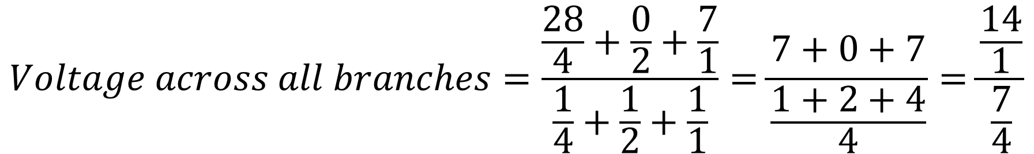
Step-2: Apply Millman’s Theorem Equation
$$Voltage across all branches=\frac{\frac{28}{4}+\frac{0}{2}+\frac{7}{1}}{\frac{1}{4}+\frac{1}{2}+\frac{1}{1}}=\frac{7+0+7}{\frac{1+2+4}{4}}=\frac{\frac{14}{1}}{\frac{7}{4}}$$

Slide 29
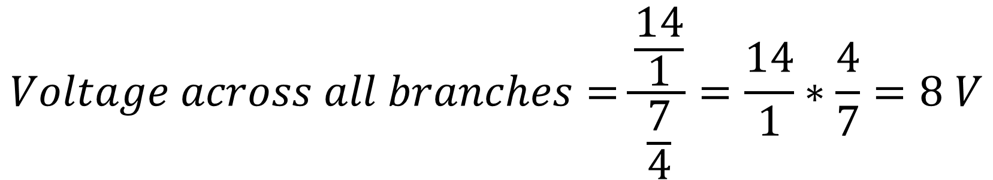
Step-2: Apply Millman’s Theorem Equation
$$Voltage across all branches=\frac{\frac{14}{1}}{\frac{7}{4}}=\frac{14}{1}∗\frac{4}{7}=8 V$$

Slide 30
Step-3: Find the Voltages across each resistor
$$Voltage across all branches=8 V$$
$$E_{R1}=Voltage across all branches−Branch Voltage= 8−28=−20 V$$
$$E_{R2}=Voltage across all branches−Branch Voltage= 8−0=8 V$$
$$E_{R3}=Voltage across all branches−Branch Voltage= 8−7=1 V$$

Slide 31
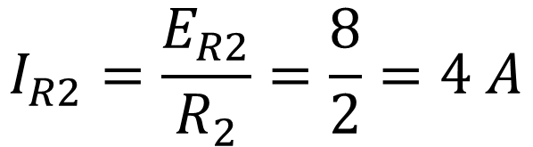
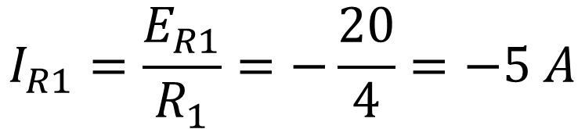



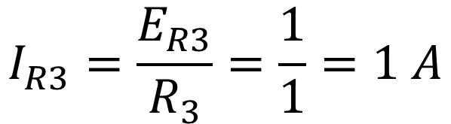
Step-4: Find the Current across each reisitor
$$Voltage across all branches=8 V$$
$$I_{R1}=\frac{E_{R1}}{R_{1}}=−\frac{20}{4}=−5 A$$
$$E_{R1}=−20 V$$
$$E_{R2}=8V$$
$$I_{R2}=\frac{E_{R2}}{R_{2}}=\frac{8}{2}=4 A$$
$$E_{R3}=1 V$$
$$I_{R3}=\frac{E_{R3}}{R_{3}}=\frac{1}{1}=1 A$$

Slide 32
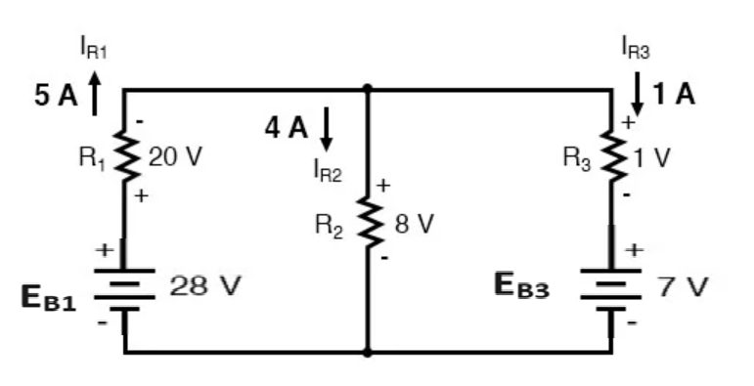
Step-5: Assigning Direction of Voltages and Currents

